Slide 1
Dimension Reduction: Partial Least Squares Regression and Considerations in High Dimensions
Sections 6.3.2 through 6.4.4
Machine Learning II - Team 6
Spring 2017
Henry Mark, Greg Noordanus, Benjamin Salvail, & Hillary Yarosh

Slide 2
Agenda
Partial Least Squares
Computing PLS Direction
PLS vs. PCR
High Dimensional Data
What Goes Wrong in High Dimensions?
Regression in High Dimensions
Shortcomings of Linear Regression
Interpreting Results in High Dimensions
Real World Examples
R Lab
1

Slide 3
Partial Least Squares
2
(PLS)

Slide 4
Partial Least Squares
Dimension reduction method
Identifies a new set of features which are a linear combination of the original
Fits a linear model via least squares using these M new features
Supervised alternative to PCR
What is supervised learning?
Makes use of the response Y in order to identify new features that not only approximate the old features, but also that are related to the response
Directions
Number of least squares directions is a tuning parameter typically chosen by cross-validation
Generally standardize predictors and response before performing PLS
Practicality: Often performs no better than ridge regression or PCR
3

Slide 5
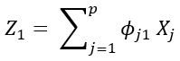
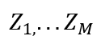
Computing PLS Directions
Standardize p predictors
Compute first direction Z₁
PLS places highest weight on variables most correlated to the response
Computing second direction Z₂
Adjust each variable for Z₁ by regressing each variable on Z₁ and taking residuals
Residuals → Remaining information that has not been explained by the first PLS direction
Use orthogonalized data in same fashion as Z₁
Repeat M times to identify multiple PLS components
Use Least Squares to fit a linear model to predict Y using in exactly the same fashion as for PCR
4

Slide 6
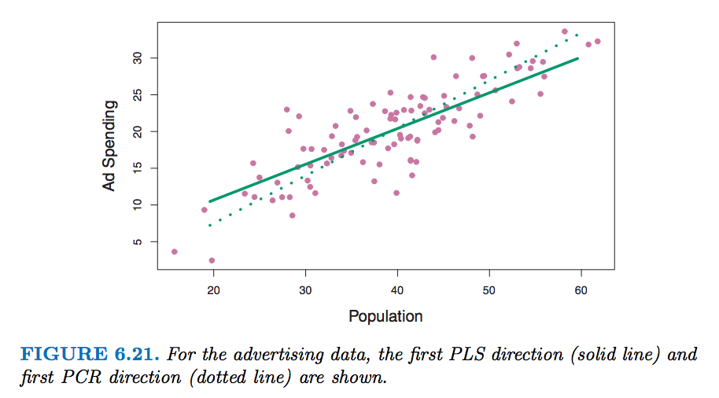
PLS Example
Solid Line illustrates the first PLS direction
Dotted Line indicates the first principal component direction
Chose a direction that changes the Population more than the Ad Spending, per unit change
Implies that Population is more highly correlated with response
PLS direction does not fit predictors as well as the PCA
However, does do a better job of explaining the response
Solid Line illustrates the first PLS direction
Dotted Line indicates the first principal component direction
Chose a direction that changes the Population more than the Ad Spending, per unit change
Implies that Population is more highly correlated with response
PLS direction does not fit predictors as well as the PCA
However, does do a better job of explaining the response
5

Slide 7
PLS
PCR
Supervised
New features are related to the response
Can reduce bias
Can increase variance
Directions explain variance in predictors and response
Dimension reduction methods
Number of M partial least squares directions used in PLS is a tuning parameter chosen by cross-validation
Unsupervised
Uses least squares and traditional measures of model fit on training data as evidence of model fit
Directions explain variance in predictors only
6

Slide 8
High Dimensional Data
7

Slide 9
Low Dimensional Data
High Dimensional Data
Number of features (p) > Number of observations (n)
High Dimensional data has become more popular due technology and the ability to collect large amounts of data.
Fields: finance, marketing, ecology, and medicine.
Example: Marketing researcher who analyzes search terms and how they relate to consumers shopping patterns. The researcher might have access to hundreds or thousands of search history, but can have many search terms.
Number of observations (n) > number of features (p)
Low Dimensional data was more common in the past with situations such as scientific problems.
Example: A model predicting a patient’s blood pressures based off some variables. In this situation, you would have thousands of patients, and only a small amount of variables.
8

Slide 10
What Goes Wrong in High Dimensions?
Incorrect to use methods such as least squares, logistic regression, LDA, and other classical statistical approaches
When p > n or p ≈ n
Example: Least squares gives coefficient estimates that result in a perfect fit to the data (residuals are 0)
Leads to overfitting of the data
Fits the training data but is inappropriate for an independent test set
R-squared is high and training set MSE is low but test MSE becomes large
9

Slide 11
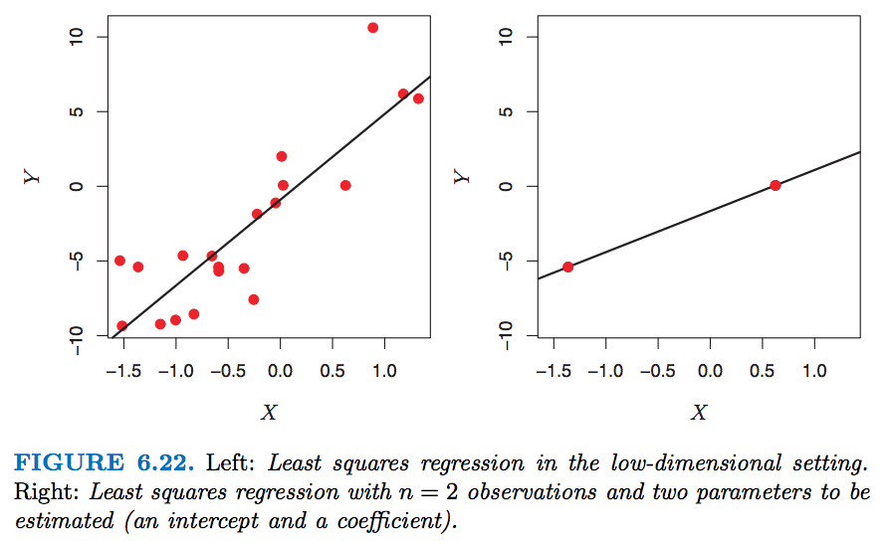
What Goes Wrong - Example
When n > p, the least squares regression tries to fit the observations as closely as possible
Resulting linear model will perform poorly
When n = 2, the regression line will fit the data precisely
Leads to overfitting
If the model on the right side is used on a test set comprised of the observations on the left, the regression line will perform poorly
10

Slide 12
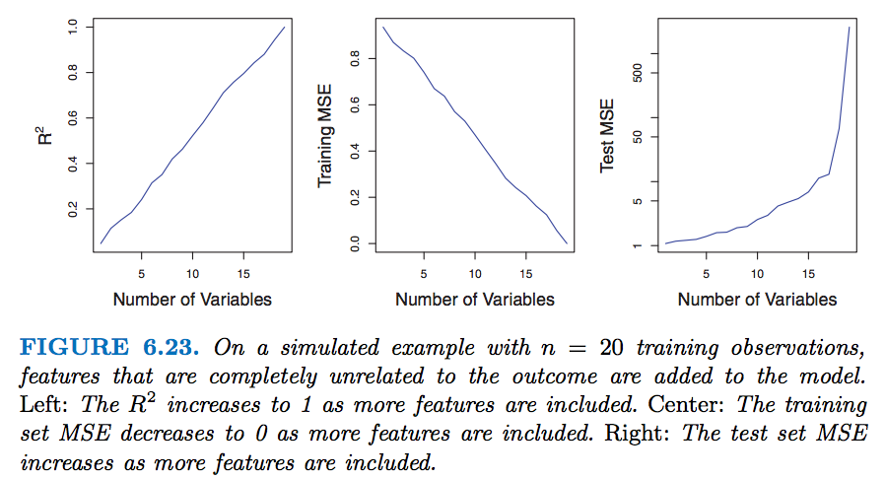
What Goes Wrong - Example
R² increases to 1
Training MSE reduces to 0
Test MSE best with a few variables
11

Slide 13
Regression in High Dimensions
Requires a less flexible fitting method than least squares
Forward stepwise selection, ridge regression, the lasso, principal components regression
Avoids overfitting
Curse of dimensionality
Test error tends to increase as the dimensionality of the problem increases
Adding noise features degrades the model
12

Slide 14
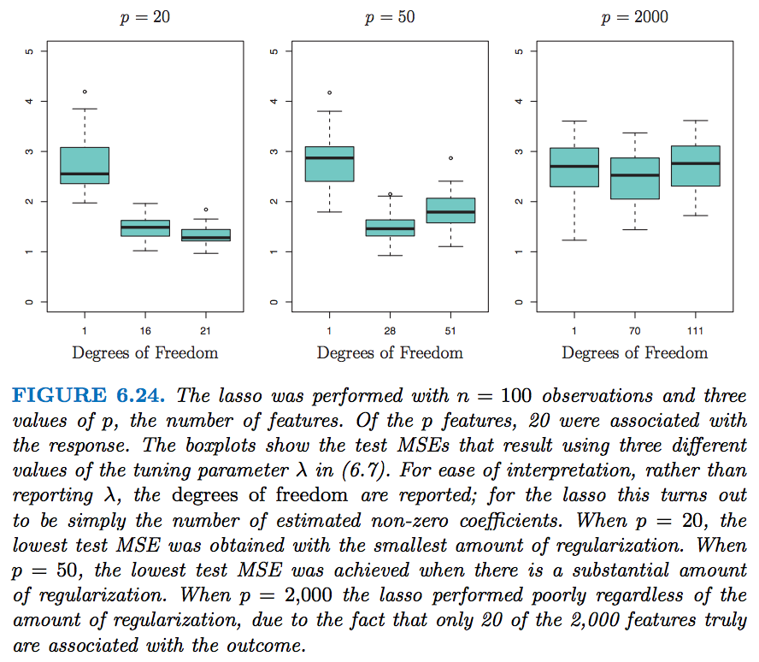
3 Thoughts:
Graphs display the role that shrinkage plays in high dimensional data
Proper tuning parameter selection is good for predictive performance
Test Error increases as dimensionality increases
13

Slide 15
Shortcomings of Linear Regression
¹
Predictive Ability: Test error incorporates the combination of both bias and variance. The shortcoming in a linear regression would be a situation where you sacrifice some bias in order lower the variance, to enhance the accuracy.
Interpretive Ability: In a situation where the number of p is large, it sometimes forces us to select only a few variables that are deemed as relevant. This steers us in the direction of only maximizing these few variables and degrading the rest to supremely small coefficient values.
These shortcomings can lead to linear regression values that are not completely accurate.
14
Notes:
Website source for two shortcomings: http://www.stat.cmu.edu/~ryantibs/advmethods/notes/highdim.pdf

Slide 16
Interpreting Results in High Dimensions
Beware of the multicollinearity problem
Any variable can be written as a linear combination of all the other variables
We can never know which variables truly are predictive of the outcome
Blood pressure example
Identified one of many possible models (worked best for that data set)
Must be further validated on independent data sets
Never use sum of squared errors, p-values, R-squared, or other traditional measures of model fit in the high-dimensional setting
15

Slide 17
Real World Examples
16

Slide 18

Microarray
³
Collection of DNA spots attached to a solid surface
Used to measure gene expression or to genotype regions of a genome
Thousands of genes (features)
Only hundreds of samples may be available
17
Notes:
https://www.ncbi.nlm.nih.gov/pmc/articles/PMC2238676/

Slide 19
Netflix Movie Ratings
⁴
Thousands of movies each with a possible 1-5 star rating
Responses limited to number of customers who rate movies
Contest: October 2006- August 2009
Challenge: Predict un-rated movies at least 10% better than Cinematch
Methods: Variations on the SVD and k-nearest neighbors
18

Slide 20

Finance ETFs
Traded portfolios are linear combinations of the underlying asset (stock, commodity, bond) prices
Relationships between stocks change over time (mergers, management shift, new products)
Other market conditions will influence the value of the fund (investor confidence, interest rate)
19

Slide 21

Patient Health Status
Challenge is to predict clinical outcomes( reduce mortality and requisite doctor appointments)
Features stemming from blood analysis, immune system status, genetic background, nutrition, alcohol- tobacco- drug-consumption, operations, treatments, diagnosed diseases, etc.
Limited amount of accessible patient records
⁵
20
Notes:
https://arxiv.org/abs/1406.5062

Slide 22
R Lab – PCR & PLS Regression
21

Slide 23
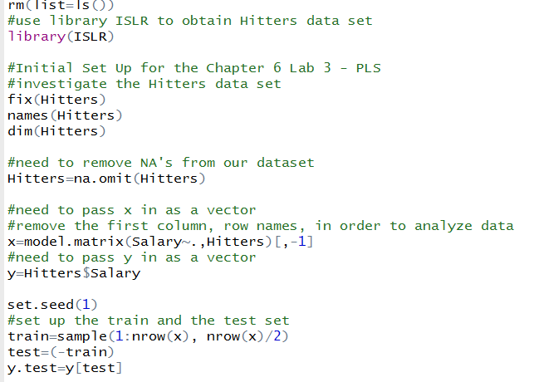
22

Slide 24
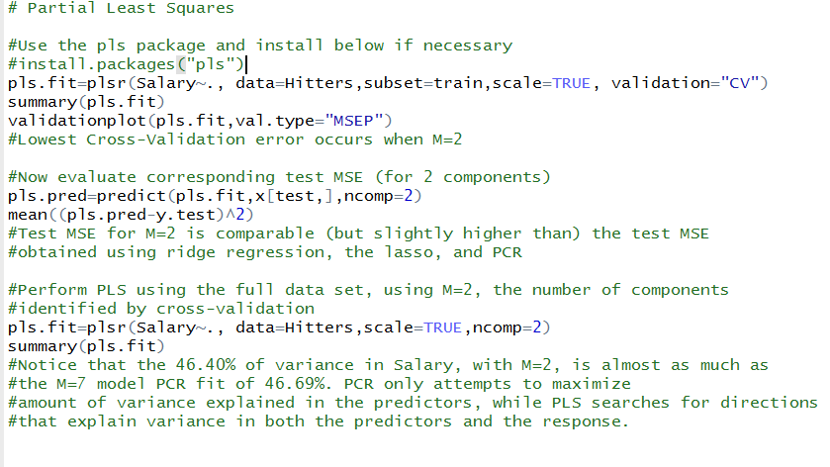
23

Slide 25
Thank You. Any Questions?
24

Slide 26
Resources
http://www.stat.cmu.edu/~ryantibs/advmethods/notes/highdim.pdf
“An Introduction to Statistical Learning” (a.k.a. ISL) by James, Witten, Hastie and Tibshirani
https://www.ncbi.nlm.nih.gov/pmc/articles/PMC2238676/
http://www.stat.rice.edu/~gallen/examples_high_dim_data.pdf
https://arxiv.org/abs/1406.5062
25

